Slide 1
Game Pitch
By
Team P

Slide 2
Game Idea Summary:
A Stealth Action game where you play as a ninja to assassinate enemy AI.
The setting takes place in Feudal Japan

Slide 3
Target Audience
For the Asian market

Slide 4
Style
Yes:
Fully genuine Japanese game
3D

Slide 5
Genre
3rd Person Stealth Game with Horror-elements incorporated in
Stealth-action game
Influences: Ninja Gaiden Black, Shinobido Series, Metal Gear Solid Series
Blended with a Visual-Novel Story
Cutscenes compose of text boxes on bottom of screen and 2D digitally-drawn art
Cutscenes of the game is played as a visual novel
Decision making in the visual novel cutscenes affect the level branching

Slide 6
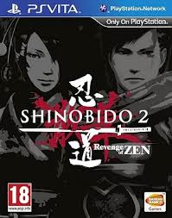
Shinobido 2: Revenge of Zen

Slide 7
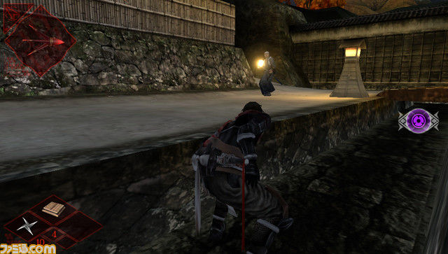
Shinobido 2- Revenge of Zen Gameplay

Slide 8
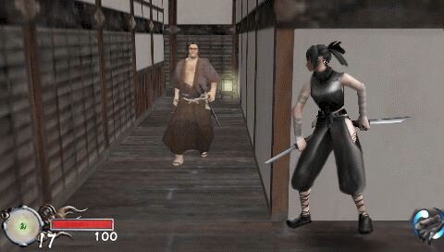
Tenchu: Shinobi Taizen Gameplay

Slide 9
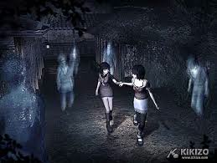
Project Zero 2

Slide 10
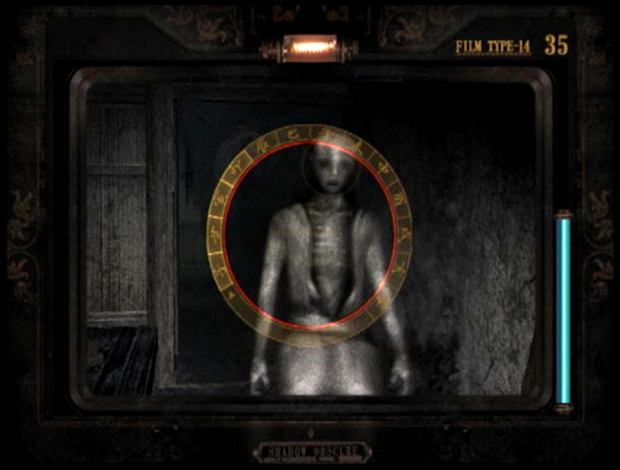
Project Zero 2

Slide 11
Game Engine
Unity3D or Source SDK. We might need school support for a Unity Pro license.

Slide 12
Team Structure
Hope to have a 3D artist and animator
Great learning opportunity!
I’ll do some
We can get models and rigs off the web
Several programmers because the game will have lots of content and levels.
Need a producer to herd the cats.

